Slide 1
Ask Weber
Nervous System 1 (Topic 10)
askweber.github.io

Slide 2
Central Nervous System

Slide 3
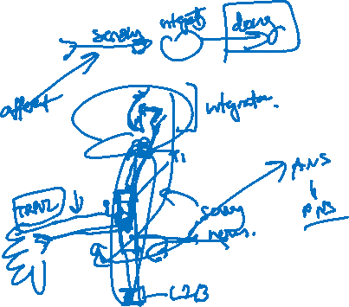
Organisation of the nervous system
What are the two systems which can be considered ‘motor pathways’?
Autonomic nervous system
Somatic nervous system
What is the difference between these two systems?
Autonomic nervous system is not under conscious control
Somatic nervous system is under conscious control
What is the difference in the type of muscles each nervous system innervates?
Autonomic nervous system – smooth muscle and cardiac muscle
Somatic nervous system – skeletal muscle
What is an ‘afferent’ pathway and an ‘efferent’ pathway in a nervous system
‘afferent’ – to feel: these are the ‘sensory’ components of our nervous system
‘efferent’ – to do: these are the ‘motor’ components of our nervous system
Name two components of the CNS
Brain
Spinal cord
Is the autonomic nervous system part of the CNS or the PNS?
Peripheral nervous system

Slide 4
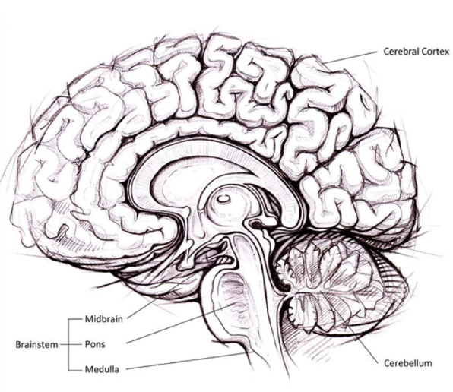
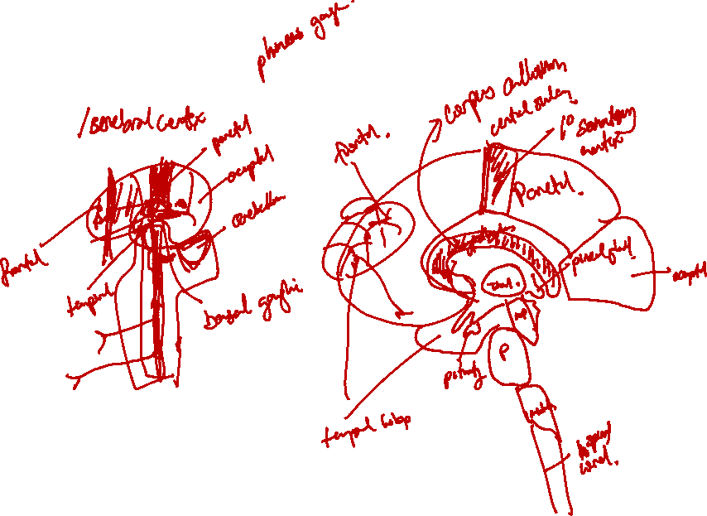
The brain
Components of the forebrain
Cerebrum
Thalamus
Hypothalamus
Pineal gland, pituitary gland
Limbic system
Components of the hindbrain
Midbrain
Brainstem
Pons
Medulla oblongata
cerebellum

Slide 5
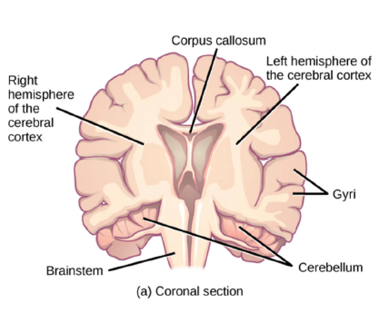
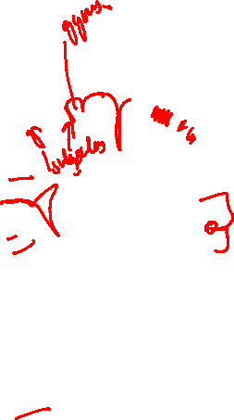
The cerebrum (cerebral cortex)
What structure joins the hemispheres?
Corpus callosum
What does the corpus callosum actually join?
The cerebral cortex (cell bodies) via the internal capsule
What *actually* is gray matter and white matter
Gray matter – cell bodies
White matter – axons
Does the inside or the outside of the cerebrum consist of the cell bodies/soma?
Define sulci and gyri

Slide 6
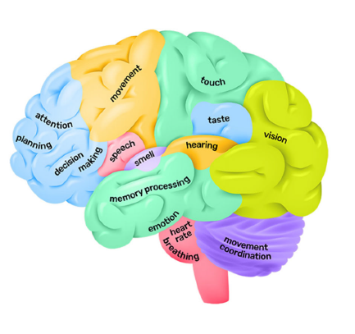
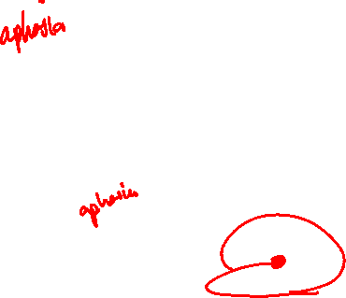
Lobes of the brain
What are the lobes of the cerebral cortex? What do they do?
Frontal cortex
Parietal lobe – integration of sensory information
Temporal lobe
Occipital lobe - vision
Which area of the brain controls speech?
What side of the brain is involved in processing of verbal language and speaking?
Left – Wernicke and Broca’s areas respectively are responsible for this
What is a stroke?

Slide 7
What lobe is responsible for this?
Following a hyperacute stroke with thrombolysis, John underwent a medical assessment. On general inspection, John demonstrated truncal ataxia. When examining him, he was past-pointing on the finger-to-nose test and had dysdiadochokinesia. When asked to stand, he demonstrated titubation. What area of the brain would you expect to see the stroke on MRI?
Cerebellum
Responsible for gait and posture
Truncal ataxia (i.e. he cant keep himself upright and still)
Titubation (i.e. cant keep himself upright and still when standing)
Responsible for muscle tone and voluntary muscle activity (and fine movement controls)
Finger-to-nose involves use of fine and complex muscle groups
Dysdiadochokinesia does the same

Slide 8
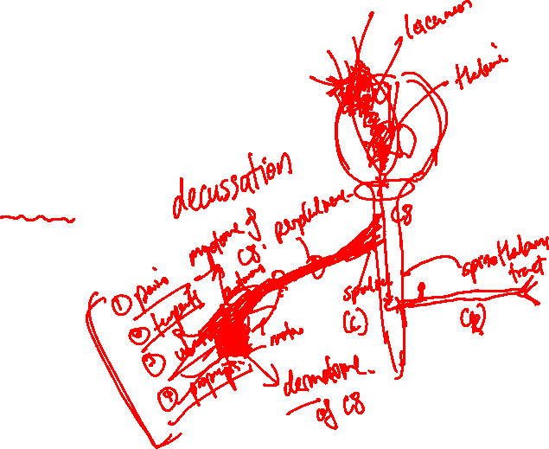
What lobe is responsible for this?
An elderly patient has a stroke and develops an aphasia (i.e. he cannot speak appropriately). What side and which lobe was likely affected by this?
Broca’s aphasia – left temporal lobe
An elderly patient has a stroke and cannot feel his right hand – where was this stroke likely?
Look at homunculus – likely the left parietal lobe

Slide 9
Forebrain functions
In the CT brain scans of many elderly patients, you will tend to find a calcified pineal gland. What hormone is primarily regulated by this gland and what does it do?
Melatonin – regulates sleep/wake cycle
Which structure in the brain is responsible for regulating hormone release from the pituitary glands?
Hypothalamus
Which hormones are released by the hypothalamic neurons into the posterior pituitary?
Oxytocin and ADH

Slide 10
Forebrain functions
When you are casually doing something and then something extremely scary happens (e.g. a car crashes in front of you), you tend to develop a very strong memory of the event. This is due to a behavioural response to the situation (most typically fear). Which component of the brain is responsible for the (a) emotional response, (b) memory formation and (c) the name of the system that links this together
A – amygdala
B – hippocampus
C – limbic system

Slide 11
When Stephen curry trains for his games, he needs to shoot many (MANY) shots. Each time he misses, he corrects himself based on the feedback (seeing himself miss) and his experience of shooting (from his muscles, joint positions, etc.). What brain component is responsible for this?
Cerebellum

Slide 12
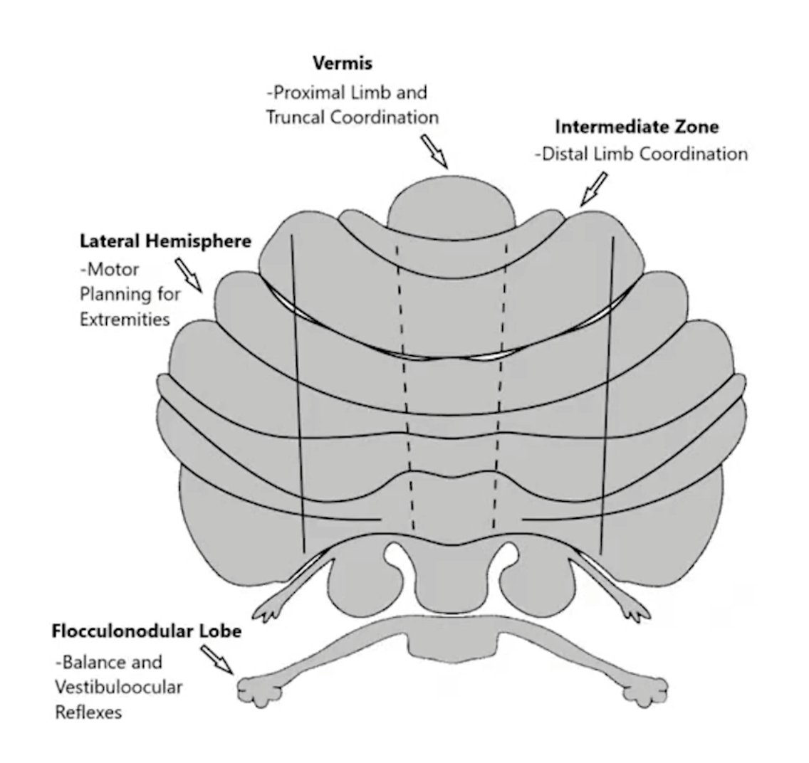
Cerebellar regions
Vermix controls:
Proximal limb and truncal coordination
Lateral hemispheres for
Motor planning for extremities
Flocculonodular lobe
Balance and vestibuloocular reflex

Slide 13
Brainstem anatomy
The medulla’s relation to the pons (anatomically) is:
Anterior
Posterior
Superior
Inferior
Lateral
Medial

Slide 14
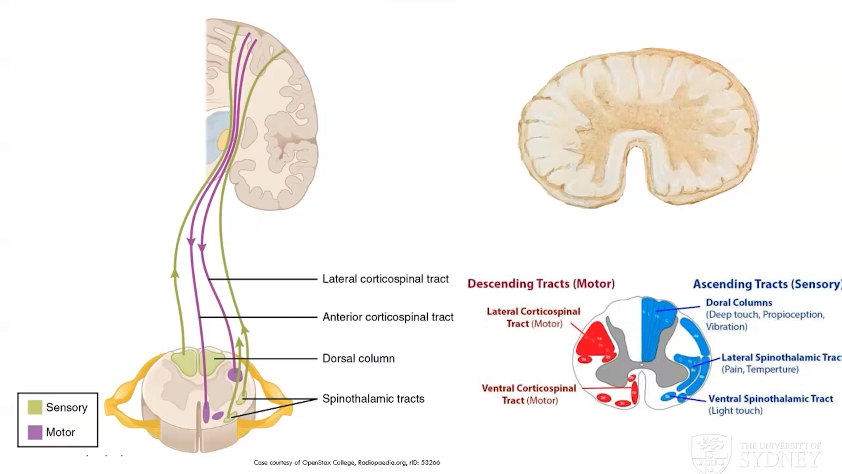
Spinal cord

Slide 15
Spinal cord continued
Is the peripheral or central component of the spinal cord made up of cell bodies?
Central spinal cord made of cell bodies – this is opposite to what you see in the cerebrum
Name the tract responsible for carrying motor fibres for voluntary muscle control
Cortic(al) to spinal – this is the corticospinal tract
What is the function of the lateral spinothalamic tract?
Pain and temperature
Name the sensory modalities
Pain + Temperature
Fine touch
Deep touch, vibration + proprioception (Dorsal columns)
Do lateral corticospinal tract neurons carry upper or lower motor neurons?

Slide 16
Decussation
Where does decussation occur?

Slide 17
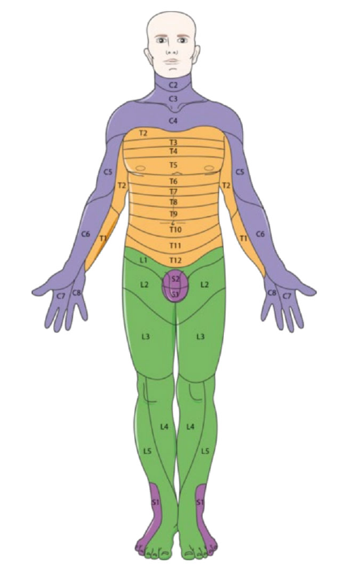
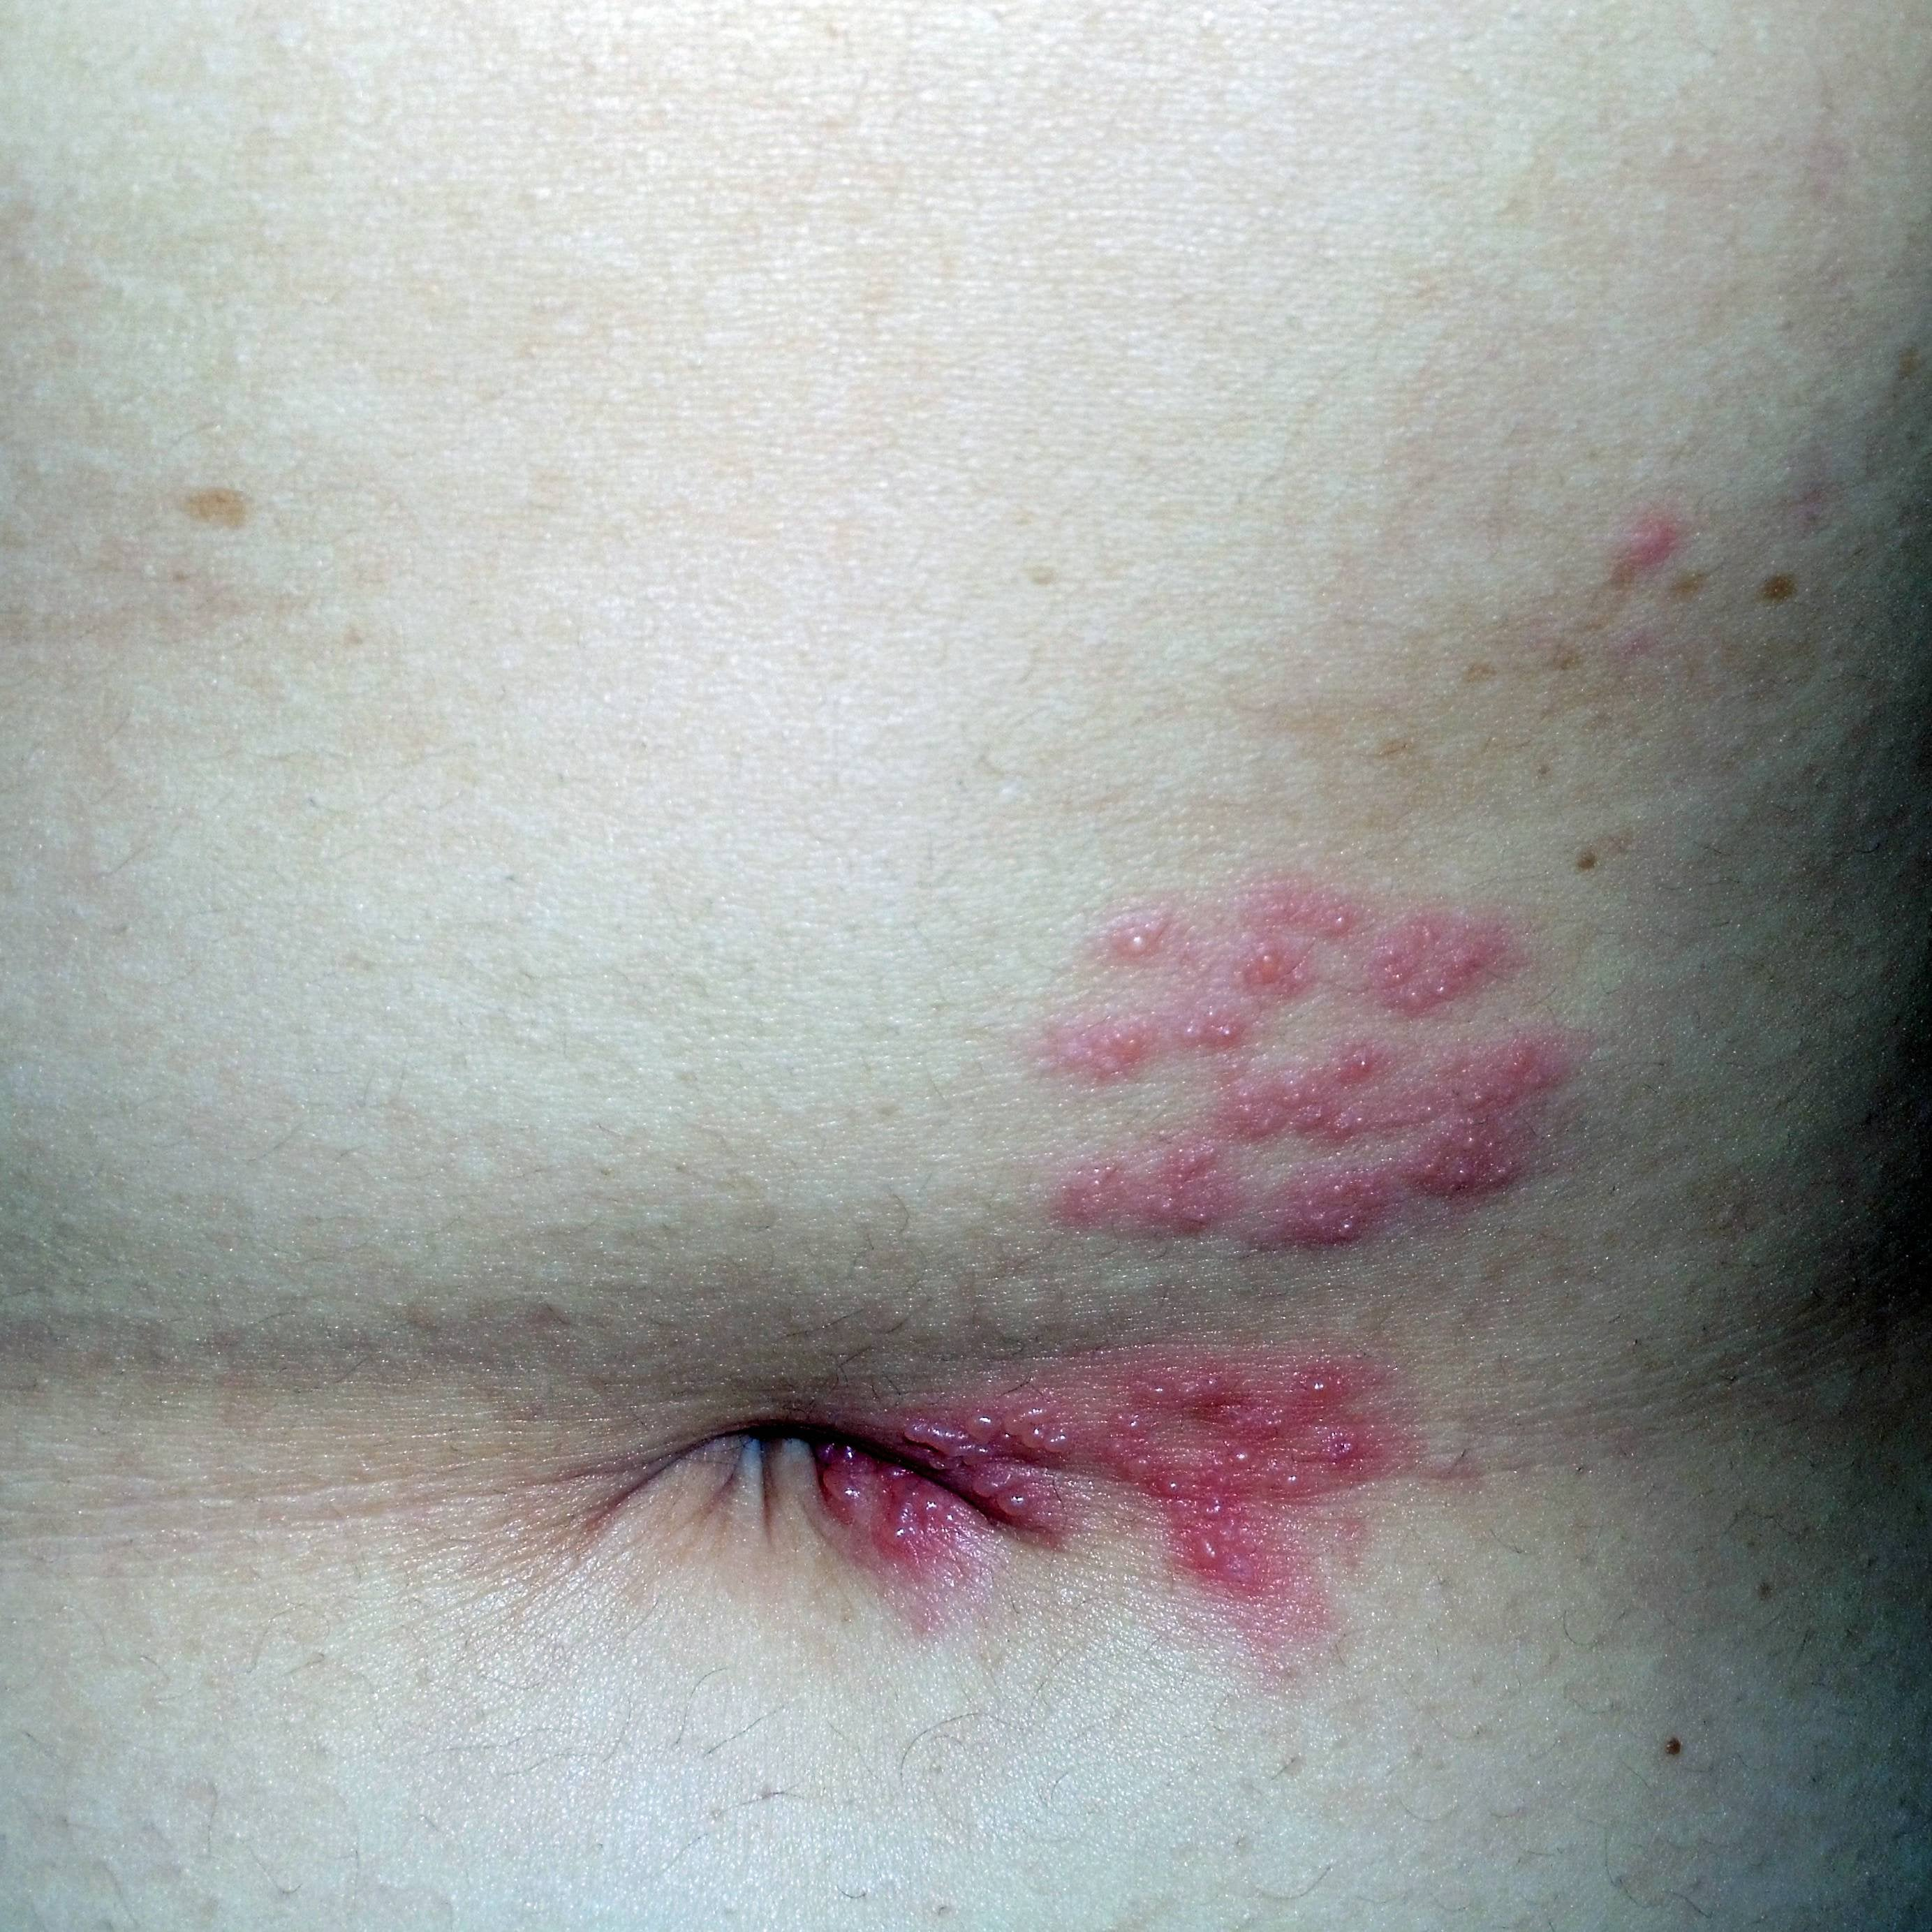
The dermatome
Shingles is an infective disorder involving reactivation of Varicella Zoster Virus (VZV) which lies dormant within the ganglia of sensory nerves following chicken pox. VZV will reactivate under certain conditions (e.g. immunosuppression, stress) and will reactivate in a single dermatomal distribution.
The following is a reddit user’s photo regarding a shingles flare – what dermatomal distribution is responsible for this?
Which spinal nerve supplies sensory innervation to the nipples and the belly button?
T4 for nipple
T10 to belly button

Slide 18
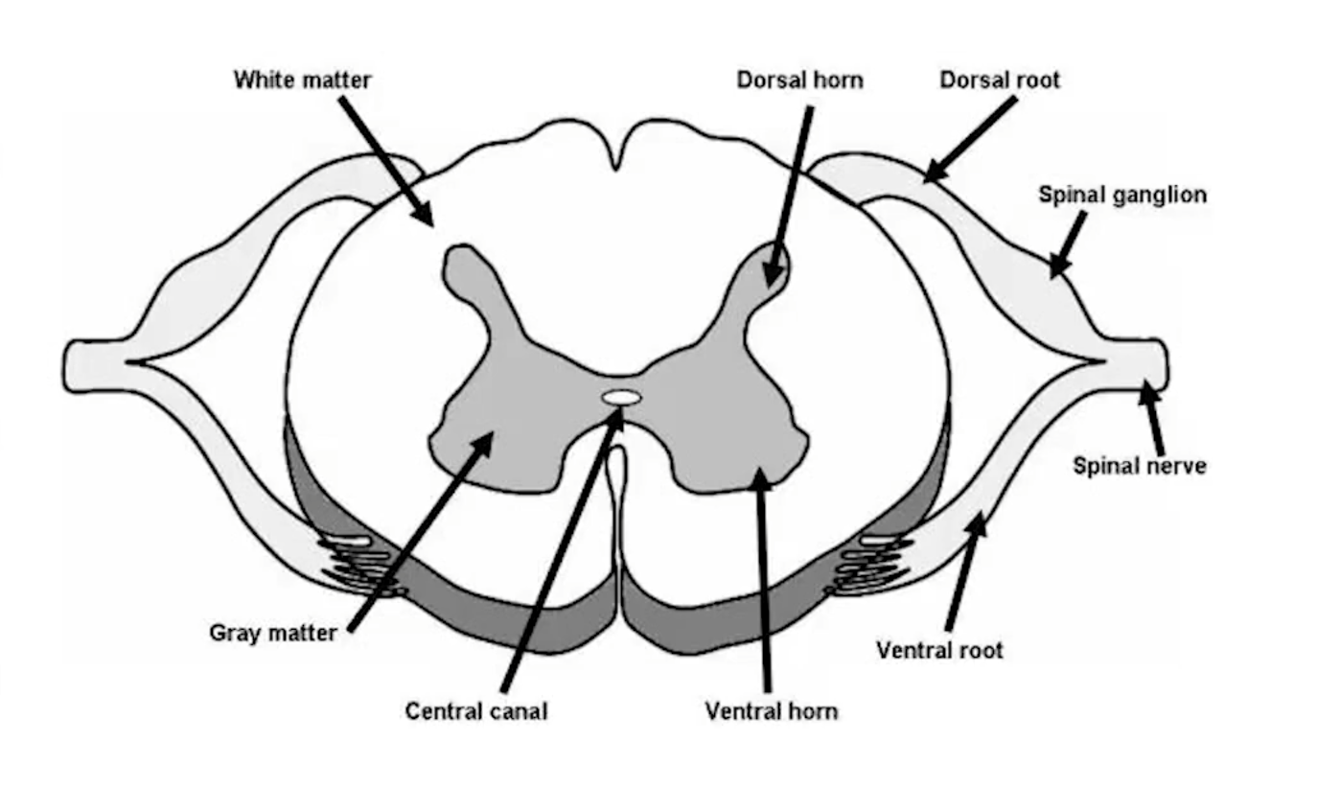
Spinal nerves
Draw a section of the spinal cord with the lateral-most included point being the spinal nerve

Slide 19
Cranial nerves
Name the 12 cranial nerves

